Slide 1


ATLIQ GRANDS HOSPITALITY ANALYSIS
By Talluri Kiran Datta

Slide 2

Problem Statement
AtliQ Grands owns multiple five-star hotels across India. They have been in the hospitality industry for the past 20 years. Due to strategic moves from other competitors and ineffective decision-making in management, AtliQ Grands are losing its market share and revenue in the luxury/business hotels category. As a strategic move, the managing director of AtliQ Grands wanted to incorporate “Business and Data Intelligence” to regain their market share and revenue. However, they do not have an in-house data analytics team to provide them with these insights.
Their revenue management team had decided to hire a 3rd party service provider to provide them with insights from their historical data.

Slide 3

Key Metrics
Revenue Per Available Room (RevPAR): Revenue generated per available room, regardless of occupancy status.
Average Daily Rate (ADR): The ratio of total revenue to the total number of rooms booked/sold.
Revenue Realisation %: Revenue what the property will get into its vault

Slide 4
Key Metrics
Daily Sellable Room Nights (DSRN): Average number of rooms available for sale on a given day.
Daily Booked Room Nights (DBRN): Average number of rooms booked per day
Daily Utilized Room Nights (DURN): Average number of rooms that are successfully utilized by customers for a day.

Slide 5

Dashboards:
Sales View:
Comprehensive view of key performance metrics like Revenue Trends, Booking platforms, Occupancy % across different cities, Average ratings etc.
Key Metrics Overview:
All metrics under study along with their trends.
Property Metrics:
Plots various properties with metrics such as RevPAR, Occupancy Percentage, ADR, Revenue, Realisation Percentage, Average Rating, DSRN, DURN, and Cancellations Percentage.
Cancellations View:
The dashboard is inferring patterns and trends in cancellations, highlighting which platforms, properties, and room classes experience the most cancellations. This can help in identifying areas for improvement to reduce cancellation rates and improve overall performance.

Slide 6
INSIGHTS
1. NO DYNAMIC PRICING STRATEGY:
Weekends generate less revenue than weekdays, even though they have a higher occupancy rate. Weekends, with a 62.64 % occupancy rate, generate ₹524 million, while weekdays, with a 55.9% occupancy rate, generate ₹1.18 billion in revenue. This discrepancy suggests a lack of a dynamic pricing strategy that could adjust to changing demand.
The revenue and occupancy rates for May, June, and July are nearly identical, even though April to June is typically considered the holiday season. This indicates a lack of seasonal variation. AtliQ Grands is unable to capitalize on this increased demand.
Contd….

Slide 7
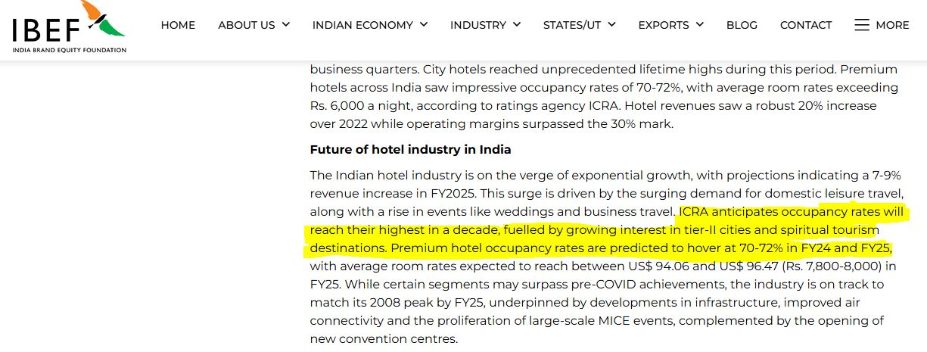
Based on reports from Smith Travel Research (STR), HVS Anarock, FHRAI (Federation of Hotels and Restaurant Association of India)
2. BELOW-MARKET PERFORMANCE:
India's occupancy rates, reflecting strong demand, are estimated to be at 70%, particularly for the premium and luxury segments. AtliQ Grands, with occupancy rates ranging from 58% to 60%, is lagging industry standards.
Contd…

Slide 8
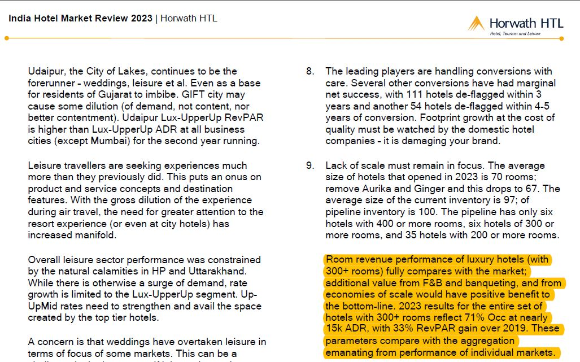
The industry benchmark Average Daily Rate (ADR) for luxury-class hotels in Tier-1 Indian cities is ₹15,000. Atliq Grands, with ADR for its Elite class (11,320) is below ₹15,000.
All the cities in which AtliQ Grands operates has ADR value below the market benchmark.
Contd…

Slide 9

3. CANCELLATIONS:
Direct offline channel exhibit the lowest cancellation percentage among all booking platforms. AtliQ Grand should prioritize transparently listing its amenities and policies or consider partnering with a more suitable booking platform.
Elite Category tops the cancellations amongst the room classes (12,357).
Mumbai, despite being the highest revenue-generating city at 668 million INR, also exhibits the highest cancellation rates (10,754). Atliq Grands should reassess its business approach in Mumbai to mitigate this issue.
This shows a gap between AtliQ Grand’s service and consumer expectations.
Atliq Palace has the highest cancellations amongst the properties (5949), while Atliq Seasons has the least at 987.

Slide 10

THANK YOU

